Slide 1
Privilege
Deakin
390G.Day 3
Summer 2015

Slide 2
Richard Cory—Edwin Arlington Robinson
Whenever Richard Cory went down town,
We people on the pavement looked at him:
He was a gentleman from sole to crown,
Clean favored, and imperially slim.
And he was always quietly arrayed,
And he was always human when he talked;
But still he fluttered pulses when he said,
"Good-morning," and he glittered when he walked.
And he was rich—yes, richer than a king—
And admirably schooled in every grace:
In fine, we thought that he was everything
To make us wish that we were in his place.
So on we worked, and waited for the light,
And went without the meat, and cursed the bread;
And Richard Cory, one calm summer night,
Went home and put a bullet through his head.

Slide 3
EQ: Lens of Social Power
How does this text comment on or represent class conflict?
Pgs. 58-59 Establishing a context for teaching

Slide 4
Somewhere in America
https://www.youtube.com/watch?v=OadZpUJv8Eg
EQ: How does this text comment on or represent conflict?

Slide 5
Othello, Acts I and II
Activity 13
Revisit your reading and find instances that represent the three tenets of Marxism:
  Class Struggle
  Internal Contradictions
  Class Consciousness

Slide 6
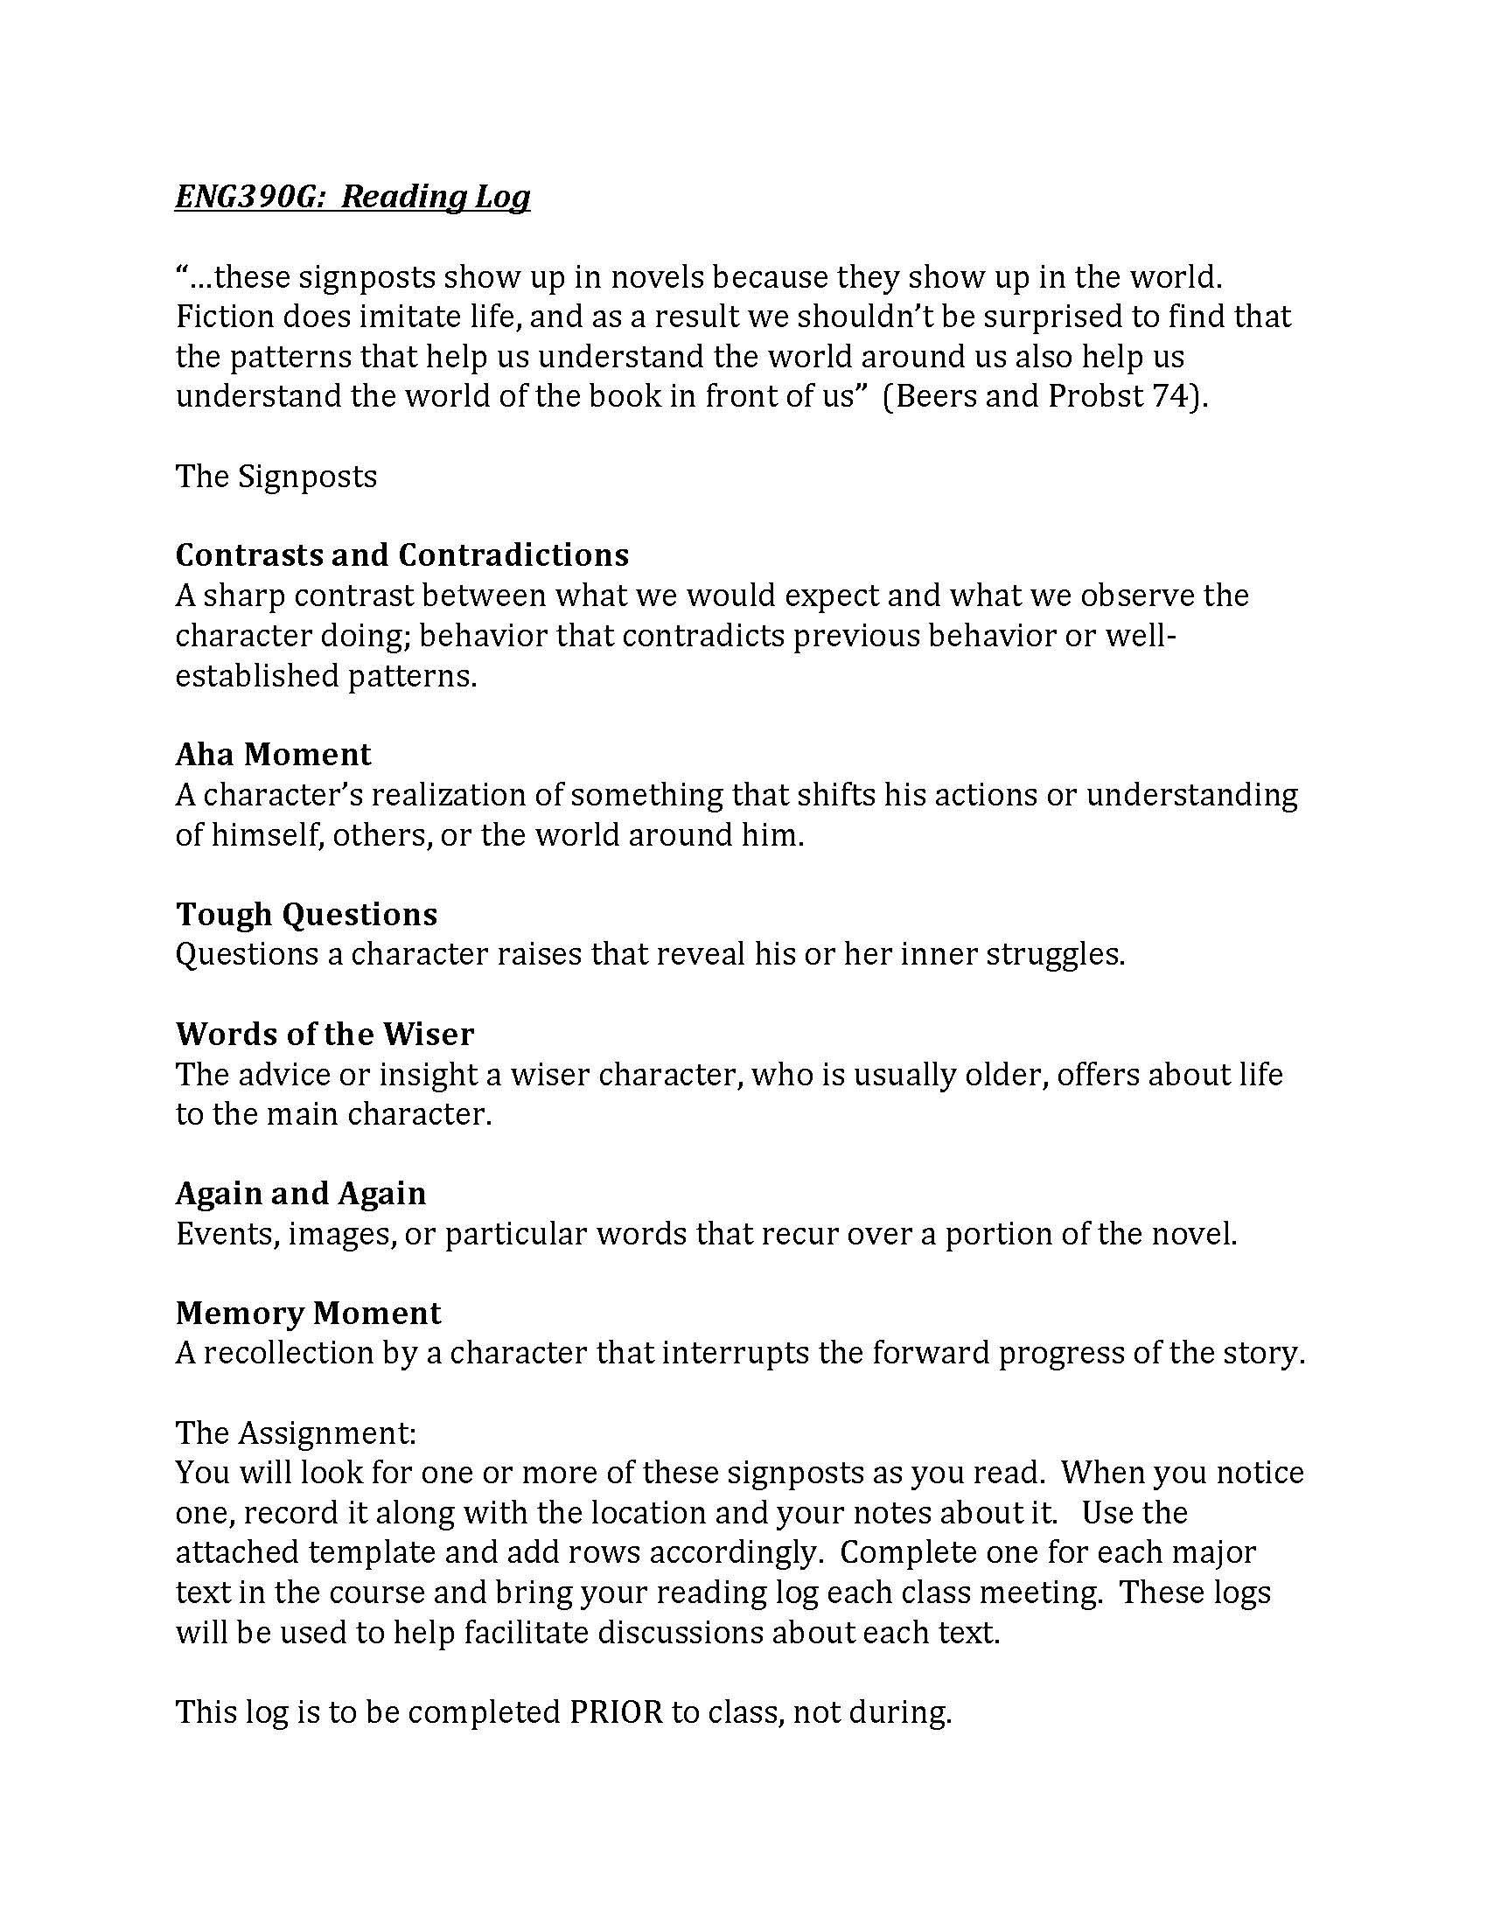
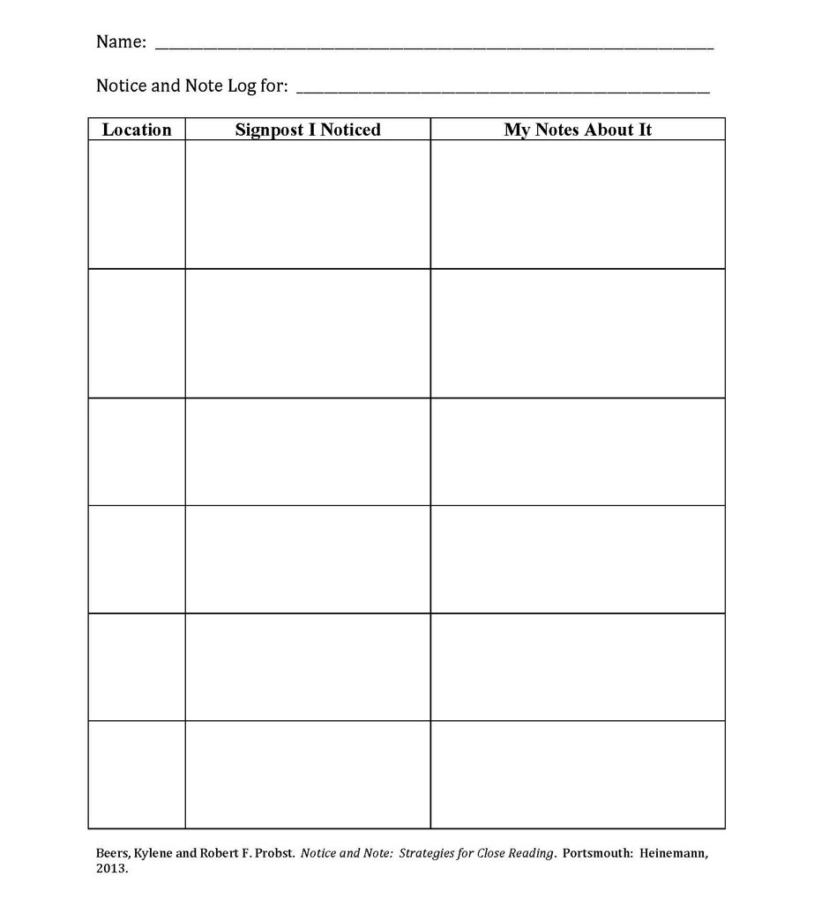
Jago and Accountability

Slide 7
For Wednesday
Act III
Review the 1st 2 page paper assignment

